Slide 1
Powered By DIGIT360 Sdn Bhd – UiTM Startup Company
4th MALAYSIA
INVENTION AND INNOVATION EXPO
2025 - ONLINE
https://miix.my/
https://t.me/miixsupport
miix22.secretariat@gmail.com
https://registro.miix.my/
https://t.me/digit360hq

Slide 2
What is MIIX?
Get the most out of our event. Featuring innovations from diverse fields and streams, MIIX is aiming to nurture the culture of innovation and design in the field of teaching and learning and other related fields among educators, students, and the public.
MIIX provides a prestigious platform for educators, librarians, students, and the public to participate and showcase their innovations and designs through a digital platform.

Slide 3
Organizer and Strategic Partners

Slide 4
MIIX HISTORY
Malaysia Invention and Innovation Expo
PARTICIPANTS
Actual
Forecast

Slide 5
What to Expect
Malaysia Invention and Innovation Expo
NETWORKING
LEARNING
EXPOSURE
Challenge your abilities with your peers!
Learn from experience of others.
Get rewards for your career advancement.

Slide 6
CATEGORY
Malaysia Invention and Innovation Expo
Expert Innovator
University Study Innovator
Open to academician, practitioners and professionals
Open to university/College/Tertiary education students
SVM/DVM is eligible for this category

Slide 7
CATEGORY
Malaysia Invention and Innovation Expo
School Authorization Letter is mandatory for Junior and High School Innovator
Junior School Innovator
High School Innovator
Open to primary school students.
Age: 7 to 2 years
Open to secondary school students.
Age: 13 to 17/18 years
All project(s) must have teacher as advisor/contact person

Slide 8
School Letter
Malaysia Invention and Innovation Expo
Register New Project
Select either category for Primary or Secondary School.
Fill all details including TEACHER as advisor and contact person.
Submit
Go to DASHBOARD and DOWNLOAD the School Authorization Letter.
Fill the details for contact person.
Copy the wording into School’s official letterhead.
Obtain signature and official stamp from school.
Scan and save letter as PDF.
Upload to Google Drive and Set permission to ‘Anyone Can View’.
Submit with the YouTube URL.

Slide 9
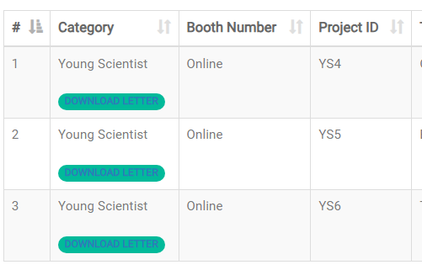
School Letter
Malaysia Invention and Innovation Expo
Download the Automatic School Authorization letter and copy into school official letterhead

Slide 10
School Letter
Malaysia Invention and Innovation Expo
Fill the detail for contact person. Its mandatory to have a teacher as advisor for Primary and Secondary school project.

Slide 11
FEE
Malaysia Invention and Innovation Expo

Slide 12
POSTER
Malaysia Invention and Innovation Expo

Slide 13
IMPORTANT DATE
Malaysia Invention and Innovation Expo
Important Date
MIIX 2025 Important Date
RESULTS
May 2025
JUDGING
May 2025
REGISTRATION
1 December 2024 – 30 April 2025

Slide 14
RULES & REGULATION
Malaysia Invention and Innovation Expo
NUMBER OF MEMBERS
YOUTUBE
#RULES 1
#RULES 4
Maximum of 8 members per project including teacher/advisors.
All video must be uploaded to your own YouTube Channel. Please set the video permission to either Unlisted or Public.
PROJECT LEADER
VIDEO VALIDITY
#RULES 2
#RULES 5
Intermediate and beginner MUST BE LED by an active students. Failure to comply may resulted with disqualification of the participation.
Date of presentation video MUST BE WITHIN the duration of the event (December 2023 to 31st March 2024). Any video submitted with previous date will not be consider for the Best Video Award.
VIDEO DURATION
PAYMENT & RESULT
#RULES 3
#RULES 6
Presentation video should be within 4 minutes to a maximum of 6 minutes 30 seconds. Participant must introduce themselves in the opening of the presentation video.
All payment is non-refundable.
All result is non-negotiable.

Slide 15
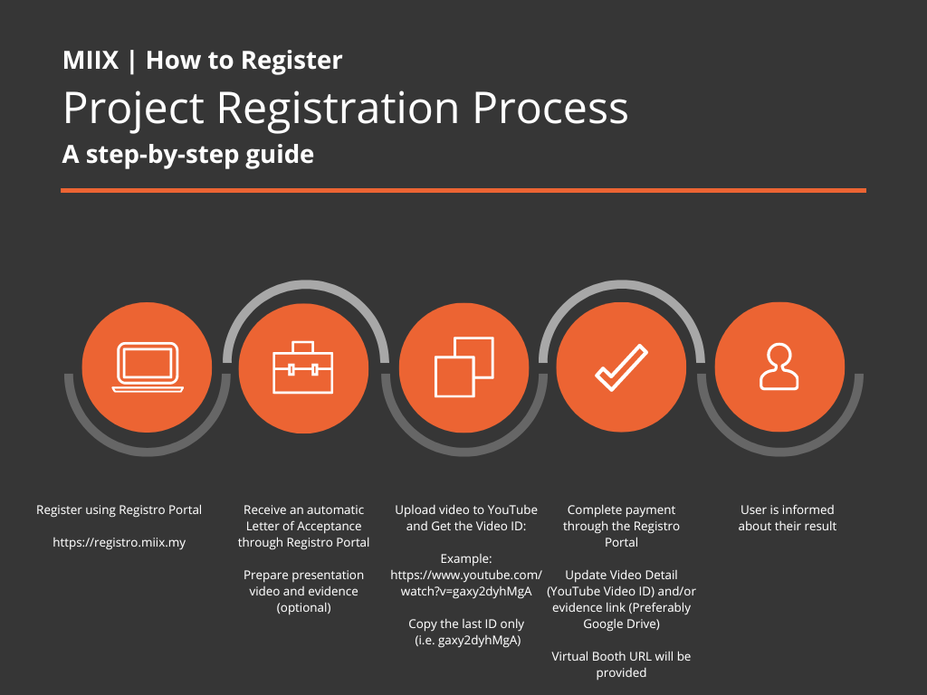
HOW TO REGISTER
Malaysia Invention and Innovation Expo

Slide 16
HOW TO REGISTER
Malaysia Invention and Innovation Expo
Step 1
Register new account at https://registro.miix.my
Step 2
Login using email (username) and password.
Step 3
Click ‘New Project’ to create new submission.
Step 4
New project will be available at dashboard.
Submit
Click ‘Pay Now’ to confirm the payment.

Slide 17
HOW TO REGISTER
Malaysia Invention and Innovation Expo
Step 5
Prepare presentation video.
Step 6
Upload video to your YouTube channel.
Step 7
Click ‘Upload Video’ in Registro and paste the YouTube Video URL.
Step 8 (Optional)
Optional – you may submit additional documents if necessary – such as copyright, certs, patent, testimony, etc.
Submit
Upload to Google Drive and set permission to ‘Anyone can View’
Maximum duration is 6 minutes 30 seconds.
Set permission to either Public or unlisted.

Slide 18
VIDEO CONTENTS
Malaysia Invention and Innovation Expo
Innovation and Creativity:
Significance and Impact:
Technical Excellence:
Practical Applicability:
The award-winning invention should showcase a high level of innovation and creativity. It should demonstrate a unique and inventive solution to a problem or a groundbreaking improvement upon existing technologies.
The invention should have significant potential for impact and contribute to advancements in its respective field or industry. It should address a critical need, solve a pressing problem, or offer substantial improvements over existing solutions.
The award recipient should demonstrate technical excellence in the development and implementation of the invention. The invention should showcase a deep understanding of the underlying principles and exhibit exceptional technical skill in its design, functionality, and operation.
The invention should have practical applicability and demonstrate the potential for real-world implementation. It should possess the necessary features, scalability, and adaptability to be effectively deployed in relevant contexts.

Slide 19
VIDEO CONTENTS
Malaysia Invention and Innovation Expo
Market Potential and Commercial Viability:
The award-winning invention should exhibit market potential and commercial viability. It should demonstrate potential demand, marketability, and feasibility for commercialization. Factors such as market analysis, business models, and potential partnerships or investment opportunities may be considered.
Scientific Rigor:
Intellectual Property Protection:
Presentation and Communication:
The invention should be grounded in sound scientific principles and methodologies. It should demonstrate rigorous research, experimentation, and evidence-based approaches in its development and validation.
The inventor should have taken appropriate measures to protect their intellectual property rights. Documentation and evidence of patent filings, copyrights, or other relevant intellectual property protection should be provided.
The quality of the presentation and communication of the invention is crucial. The award recipient should effectively and compellingly communicate the value, impact, and potential of their invention through clear and engaging presentations, documentation, and visual aids.

Slide 20
VIDEO CONTENTS
Malaysia Invention and Innovation Expo
Ethical Considerations:
Originality and Uniqueness:
The invention should adhere to ethical standards and considerations. It should not involve any illegal or harmful activities and should align with principles of social responsibility and sustainability.
The award-winning invention should exhibit originality and uniqueness. It should differentiate itself from existing solutions or demonstrate significant improvements upon previous inventions.

Slide 21
MIIX AWARDS
Malaysia Invention and Innovation Expo

Slide 22
MIIX MEDALS
Malaysia Invention and Innovation Expo
1 Medal is given for Expert and University Innovator
Junior and High school participant may purchase medal after the result
Additional medal is available for purchase at RM50/medal

Slide 23
MIIX MEDALS
Malaysia Invention and Innovation Expo
MEDAL
Awarding Percentage
30% Gold **
40% Bronze **
30% Silver **
** Based on jury decision, originality of innovation and other rules and/or regulation.
** All decision is final. No appeal will be entertained.

Slide 24
THANK YOU FOR YOUR INTEREST
Malaysia Invention and Innovation Expo
Powered By DIGIT360 Sdn Bhd – UiTM Startup Company
https://digit360.com.my

